Slide 1
Brain tumour diagnosis

Slide 2
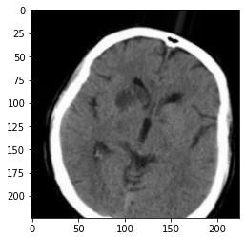
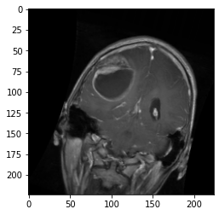
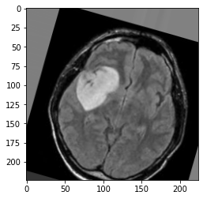
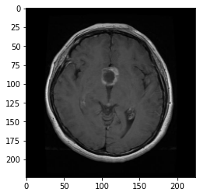
Data
Data is collected from Kaggle
MRI images with sagittal, frontal and transverse.
URL:
https://www.kaggle.com/datasets/sartajbhuvaji/brain-tumor-classification-mri
Data are divided into four classes:
0: No tumour
1: Glioma tumour
2: Meningioma tumour
3: Pituitary tumour
No tumour
Glioma tumour
Meningioma tumour
Pituitary tumour

Slide 3
Convolution Neural Network
The AI model been used in this application is Vgg19.
It is a supervised-learning model and based on transfer-learning method.
Before training:
Images are separated into train, validation and test sets.
Conducting image augmentation.
Setting an early-stopping point and saving the best result during training.
(Avoiding over-fitting)

Slide 4
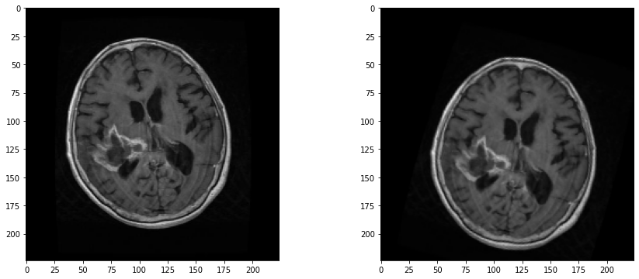
Architectures
Images augmentation can generate more data.
Images are compressed to 224,224,3 for feeding the model.
5740 images
64% for training
16% for validation
20% for testing
Vgg19
To 4 classes
Flatten
128
4
Fully connection layer

Slide 5
Result
Accuracy: 84%
 | precision | recall
No tumour | 0.83 | 0.71
Glioma tumour | 0.88 | 0.87
Meningioma tumour | 0.79 | 0.77
Pituitary tumour | 0.86 | 0.95

Slide 6
Thanks for watching

